Slide 1
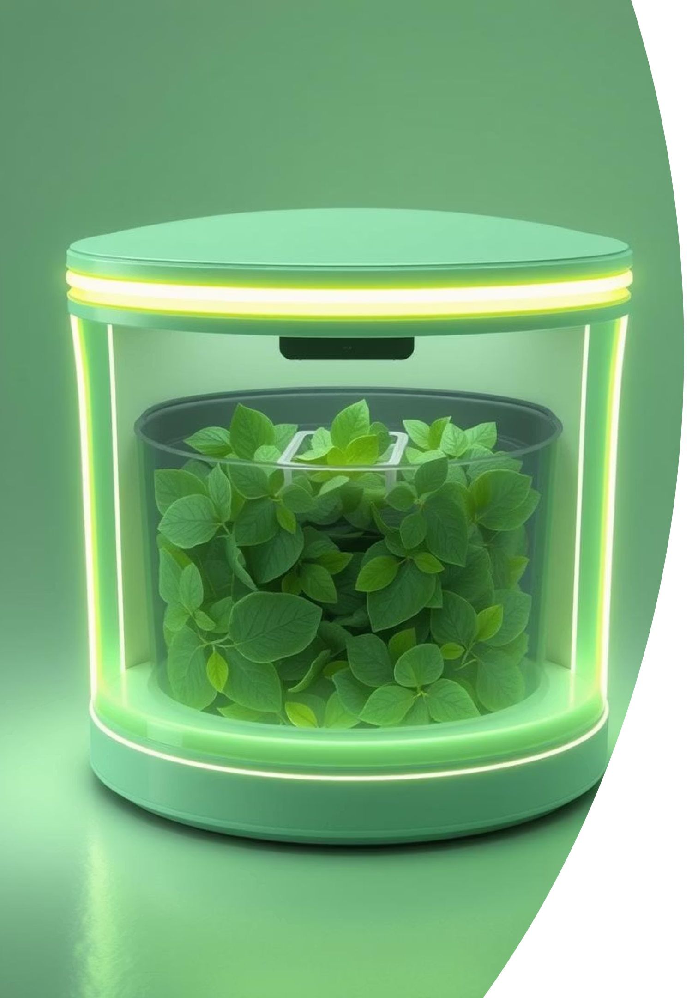
Presenting BINFINITY: An AI-Powered Garbage Classifier
Prepared By:
Manav Acharya
Bikash Bist
Anuj Kumar Thakur
Sumit Mahato

Slide 2
Software Overview
BINFINITY leverages a reliable combination of AI and computer vision libraries:
TensorFlow/Keras: For image classification model..
YOLOv5: For object classification model.
MediaPipe: For accurate hand gesture tracking for interactive control.
OpenCV: Manages webcam access for real-time visual input.
com0com: Utilized for testing virtual serial communication with Arduino IDE.
Our project contains multiple scripts, each with a unique combination of these libraries, designed for a specific task.

Slide 3
BINFNITY System Workflow
python script runs —> openCV accesses webcam —> Our AI models predicts the type of waste from 2 classes i.e. "paper"/"plastic" —> the output from .py file is sent to Arduino's COM (Communication Port) by the means of serial communication —> arduino controls the servo motor's opening the respective garbage bin —> Sensor detect the user's hand closing the bin.

Slide 4
Hardware Components
The physical implementation of BINFINITY relies on a suite of integrated hardware:
Servo Motors: Drive the automatic opening and closing mechanisms of the garbage compartments.
LEDs: Provide visual feedback for ON/OFF signal.
Arduino UNO/Bluetooth Module: Acts as the central microcontroller, managing sensor inputs and motor outputs.
IR Sensor: Detects hand presence for touchless closing after waste disposal.
Ultrasonic Sensors: Monitor fill levels within the bin compartments to prevent overflow.

Slide 5
Garbage Bin Dimensions
The HC-SR04 ultrasonic sensor, with its 16 mm diameter and 15° cone beam, necessitates specific bin dimensions to prevent false readings. At a height of 20 cm, the beam covers approximately 5.26 cm in width.
To ensure optimal performance and avoid wall interference, the garbage bin's height is set at 20 cm, with top dimensions of at least 10 cm. This design prevents the sensor's detection cone from striking the interior walls, ensuring accurate fill-level measurements.

Slide 6
Conclusion: Advancing Waste Management
Our Project also pratially touches other domains of the Techno-morph hack-a-thon.
Health
Environmental
Proper waste disposal directly corelates to better health.
Again, proper waste management is one of the most crucial step to achieving a healthier environment.
Automation
Sustainability
This project also simulates robotic automation along with AI assistance.
Proper waste management encourages recycling which in return promotes sustainability.

Slide 7

We Are Open to Suggestions
Thank you for your time and attention.
All the code is provided below:
Github Repository

